Slide 1
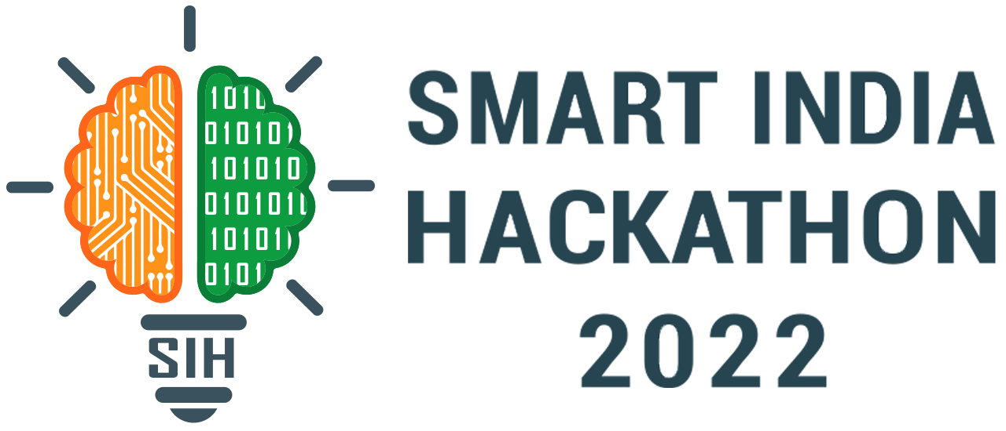
Basic Details of the Team and Problem Statement
Ministry/Organization Name/Student Innovation: AICTE, MIC-Student Innovation
PS Code: SM960
Problem Statement Title: Student Innovation
Team Name: ------
Team Leader Name: Srishti Gautam
Institute Code (AISHE): U-0923
Institute Name:VIT Bhopal University
Theme Name: Phytoremediation of soil

Slide 2
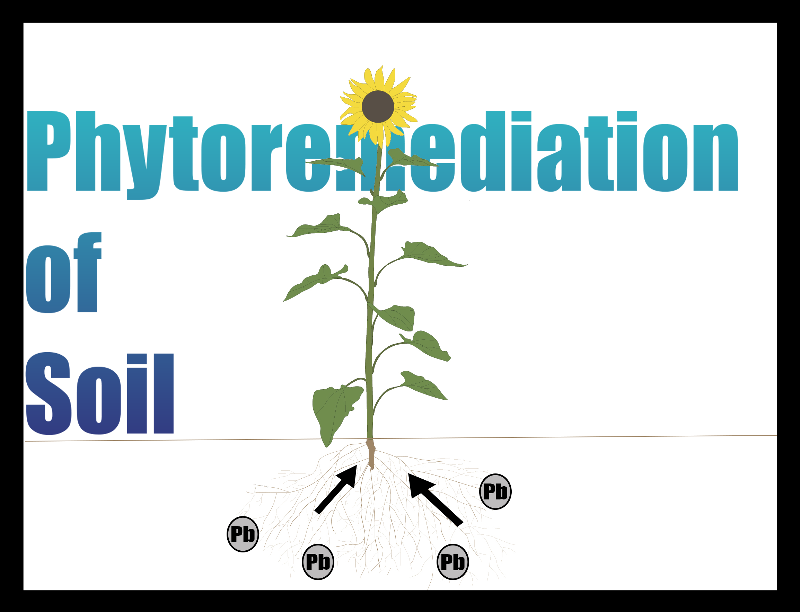
Idea/Approach Details
Describe your idea/Solution/Prototype here:
Our solution is towards the problem of soil contamination. Soil contamination is very toxic for humans, referring to it we looked for a solution. Our idea is to reduce soil contamination with biodegradable materials. The majority of the soil which is used for farming contains lead(Pb) in it. Our idea includes alternate cropping of sunflower, which can help very much in neutralizing the soil contamination from lead. Also, sunflower is very demanding in the market, thus resulting in a greater benefit for farmers as well as consumers(economical as well as health-wise).
Describe your Technology stack here:
Soil contamination is mostly caused due to fertilizer factories, or contaminated water used by farmers. To counter that our technology is to use nature’s properties in such a way that it is economical as well as fulfilling our demand.

Slide 3
Idea/Approach Details
Describe your Use Cases here
Describe your Dependencies / Show stopper here
Best Case: Major of the soil contamination occurs mostly near industrial areas, therefore alternate crops of sunflower will show great impact in the quality of soil.
Average Case: Growing crops of sunflower in less contaminated soil won’t show much effective results.
The show-stopping concept here is that the sunflower crop which we are growing is edible/non-harmful. Sunflower plants observe a property of absorbing lead from the soil as well as not allowing it to reach parts above the stem. They store lead absorbed from soil in their stems benefitting farmers as well as consumers. Those stems (containing lead) can be sold by farmers to industries demanding lead. Therefore providing lead-free soil to farmers, which in return provide good health to consumers as well as soil. Also extracting lead from soil using sunflower and then selling it to industries will provide farmers more economic capital for their next growing season.

Slide 4
Heavy Metal Contamination
The industrial activity accelerates pollution of the biosphere, especially the soil.
Heavy metals are the most dangerous substances in the environment due to their high level of durability and toxicity to the biota.
Heavy metals will tend to absorb and adsorb very firmly to the soil matrix, and once released to the environment, it would degrade like organics by microbial activity or through chemical oxidation.
Human activities such as Mining, Smelting, Electroplating, etc. can result in contamination of soil with heavy metals.

Slide 5
Impact pH on the soil-to-plant transfer of heavy metals in a contaminated agricultural soil
Soil pH is the most important factor that controls Pb availability to plants.
Soil pH dictates Pb availability in soil as a negative correlation between Pb solubility and soil pH is noticed .
In acidic soil (pH < 7), Pb exists as aqueous Pb(H2O6)+2, while in alkaline soil (pH > 7), Pb forms aqueous complexes with OH− (hydroxyl ions).
Specific adsorption of Pb is directly proportional to soil pH . At a low soil pH (3–5), adsorption is the dominant process, whereas at a high pH (6–7), precipitation is the dominant process.
If pH sensor detects pH of soil greater than 6.5, then there is need to take further actions by farmers.

Slide 6
EFFECTS OF HEAVY METALS ON HUMAN BODY
Depending on the particle size , lead can enter through lungs.
In the body, lead is distributed throughout bone,teeth,liver,lung,brain and spleen.
Lead can cross blood brain barrier as well as placental barriers.
Some general signs and symptoms of lead toxicity are:
Fatigue
Myalgias
Abdominal pain
Seizures
Constipation
Coma
Epiphyseal lead lines in children(growth arrest)

Slide 7
pH SOIL SENSOR
AIM: To find pH level in the soil
COMPONENTS REQUIRED:
LCD 16X2
POTENTIOMETER
9V BATTERY
ARDUINO UNO R3
CAPACITORS
RESISTORS
5V REGULATOR
JUMPING WIRES

Slide 8
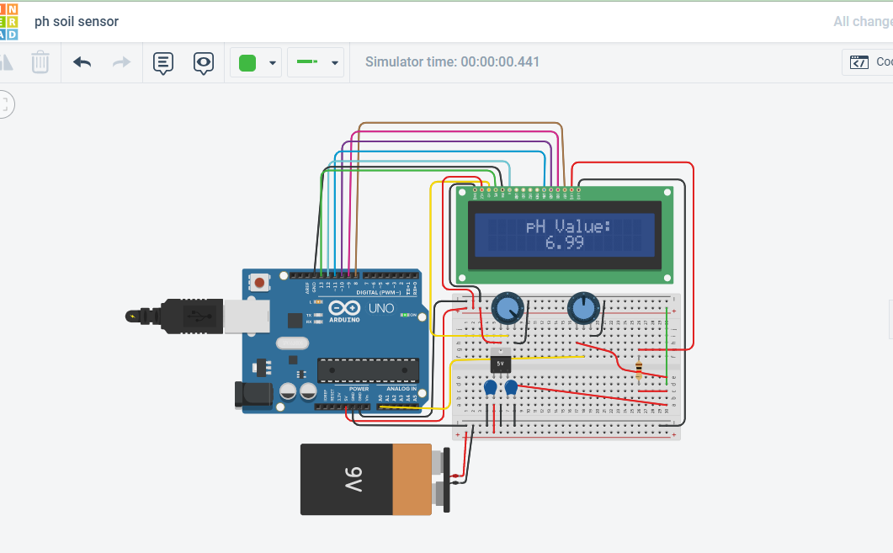
CIRCUIT DIAGRAM
https://www.tinkercad.com/things/bbyT85a4eMP-ph-soil-sensor/editel

Slide 9
CIRCUIT CODE
#include<LiquidCrystal.h>
const int rs =13,en = 12,d4 =11,d5 =10,d6 =9,d7 =8;
LiquidCrystal lcd(rs,en, d4,d5,d6,d7);
void setup()
{
Serial.begin(9600);
lcd.begin(16,2);
lcd.setCursor(4,0);
lcd.print("pH Value:");
}
void loop(){
int sensorValue = analogRead(A0);
float ph = sensorValue * (14.0/1023.0);
Serial.println(ph);
lcd.setCursor(6,1);
lcd.print (ph);}

Slide 10
BENEFITS
Cost-effective
Time saving:
For measuring lead concentration in soil nowadays, farmers have to visit laboratories with several samples which is also not convenient so in many cases ,this process is getting skipped by farmers
Portability
Availability

Slide 11
HOW pH SENSOR HELPS FARMERS
Due to industrial discharge near the farms or land, many heavy metals get contaminated in the soil like lead,mercury,cadmium etc.
There are many laboratory tests to check the presence of these heavy metals.
In India,there are many villages where such labs are not available. So many times this process is skipped by farmers.
This device helps farmers to measure the pH level of the soil. By getting the pH levels ,farmers will get an idea about the toxicity of the soil.
After getting an idea about pH and toxicity of the soil, farmers can perform further actions like phytoremediation/phytoextraction to prevent negative effects on plants of the pollutants and avoid them to enter our food web.

Slide 12
SOLUTION
1) Phyto - Plants, remediation - therapy/treatment
2) In Phytoremediation: Phytoextraction is our main solution with sunflower.
3) In this phytoextraction, sunflower plants are grown in lead contaminated soil.
4) Sunflower plant basically translocate the lead into the aboveground portion of the plant except the edible portion and limits it till it's stem.
5) Using this process, Firstly, Sunflower was grown by farmers and that can be sold in markets to earn profit as it is not contaminated from lead even though growing on contaminated soil.
6) Secondly, now the soil is free from the contamination of lead and can grow crops healthily as well as without contaminating them.
7) And finally, Sunflower's parts other than flower can be sold for lead extraction and usage and several benefits can be earned by farmers.

